Slide 1
Session 5: Behavioral Science in Action – Practitioner Presentation
Participants present the behavioral intervention they have been working on.
Participants provide feedback and score other group projects.
Prize awarded to the best group presentation.

Slide 2
Implementing Twice-Yearly Injectable Lenacapavir PrEP Among Adolescents Girls and Boys (16 - 24 years)
Vivian Mugarisi ,vivianmugarisi@gmail.com
Melaku Abebe Kassa, meleabe@gmail.com
Eva Ireri Muluve,eva.muluve@girleffect.org
Pride Ashaba,prideashaba@gmail.com
Cosmas Ndumba, cosmas@tiko.org
Edwin Bakiza, edwinbakiza@gmail.com
**Data sources**
new guidelines for use of Lenacapavir
Gears for Lenacapavir rollout
WHO Guidelines on Lenacapavir for HIV Prevention

Slide 3
What do you hope to achieve through your project/intervention?
Objective: Increase uptake, adherence, and equitable access of long-acting injectable PrEP (lenacapavir) among adolescent girls and boys (16 to 24 years) in high HIV-burden settings by overcoming adherence, stigma, and access barriers.
Target Outcomes:
Achieve higher PrEP coverage among adolescents.
Reduce new HIV infections in this group.
Empower adolescents with discreet, long-acting HIV prevention.
Improved equity in Access

Slide 4
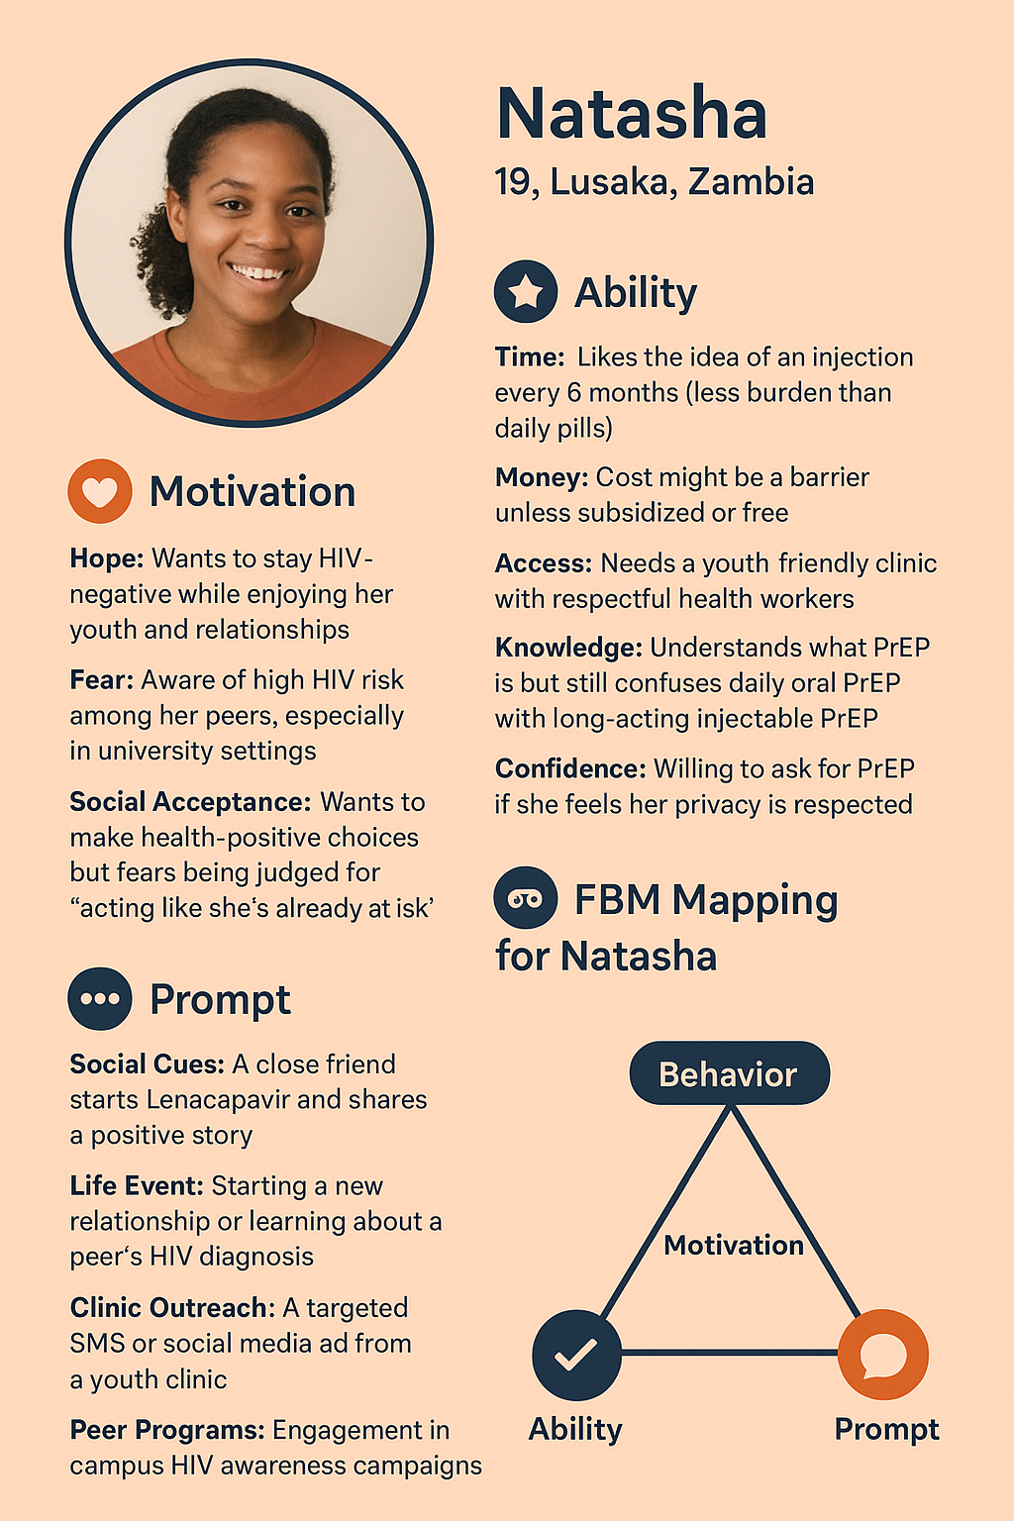
What is the specific behavior that you want to influence? (Use Person, Action, Context to write the behavior of interest.)
Person: Adolescents (ages 16–24 ), in sub-Saharan Africa.
Action: Accept and receive twice-yearly injectable lenacapavir PrEP.
Context: Youth-friendly clinics or community-based services, integrated into adolescent sexual and reproductive health programs

Slide 5
What factors drive or act as barriers to that behavior? (How do you know these are important?)
Adherence burden & pill fatigue: Adolescents find daily pills inconvenient. A long-acting injection could remove this barrier
Stigma & perceptions: Taking PrEP pills may be misinterpreted as being HIV-positive or promiscuous
Service delivery barriers: Requiring frequent clinic visits and HIV testing can limit access
Cost and funding constraints: High per-dose price and reduced global funding (e.g., PEPFAR cuts) pose implementation challenges -Pubmed UNAIDS
Legal/rights context: Adolescents need confidential, developmentally appropriate services free from discrimination.
Low knowledge & awareness: Many adolescents have limited understanding of PrEP, its benefits, and eligibility, leading to low demand and uptake
Outcome expectation barriers: Some adolescents doubt PrEP’s effectiveness or fear severe side effects, reducing willingness to start or continue.

Slide 6
How will you determine whether these factors influence the behavior of interest?
Conduct baseline assessment or secondary data analysis
Conduct assessments through qualitative interviews and focus groups with adolescents, caregivers, and providers to explore stigma concerns, preferences for injectables versus pills, and service access challenges.
Track implementation metrics: appointment adherence, rates of uptake and continuation, incidence of HIV.
Use surveys to assess changes in PrEP acceptability, perceptions, and stigma before and after introducing lenacapavir.

Slide 7
Conduct Formative assessment to understand barriers and enablers
What drives an adolescent to use injectable PrEP? Motivation
Motivation | Elements | Premises
Anticipation | Hope Fear | PrEP will protect me from HIV Desire to Stay HIV negative I am not sure my privacy will be kept at the clinic My peers may consider me as being HIV positive
Sensation | Pleasure Pain | I feel confident using PrEP I enjoy a healthier life being HIV free I worry about PrEP side effects Fear of injection twice a year
Belonging | Acceptance Rejection | Most adolescents like me use PrEP People like me should use PrEP Peers with low knowledge on PrEP may stigmatise me

Slide 8
Ability | Description
Time | I can find time to get my PrEP injection
Money | I can find money for transport to the clinic
Physical effort | It's difficult for me to visit the clinic often
Mental effort | I know where to access injectable PrEP I understand how Injectable PrEP works An injection twice a year is easier than daily pills.

Slide 9
How will you measure these drivers and barriers to behavior? (Please show exact wording of questions that you will ask)
Ability:
Adherence preference:
“Would you prefer PrEP as an injection every 6 months or a daily pill? Why?”
Perceived stigma:
“Do you worry others might think you are sick or behaving badly if seen taking PrEP?”
Service barriers:
“How often must you visit the clinic for PrEP?
“How easy or hard is it for you to get PrEP?”
Cost/accessibility:
“Would you be able to pay for an injection every six months? How would cost affect your decision?”

Slide 10
Continuation: How will you measure these drivers and barriers to behavior? (Please show exact wording of questions that you will ask)
Motivation
Knowledge and Awareness:
Which of the following statements about PrEP is true?”
□ PrEP is for people who do not have HIV
□ PrEP helps prevent HIV infection
□ I don’t know
Attitudes:
If the injection is a bit painful, would you still choose it over daily pills?
Outcome Expectation:
How confident are you that PrEP works to prevent HIV without causing serious side effects?

Slide 11
What are the next steps for you on this project/intervention?
Conduct formative assessment to understand barriers and enablers
Develop Adolescent-Centered Personas and Behavioral Journey Maps
Co-design Communication materials with young people
Pilot rollout in selected adolescent clinics, starting in high-burden, supportive policy environments (e.g., Zambia and South Africa)
Train healthcare providers on administering injectables, adolescent-friendly counseling, and simplified HIV testing protocols
Engage communities to build awareness, address stigma, and inform adolescents and families that lenacapavir is prevention, not treatment.
Collaborate with funders and policymakers to secure affordable pricing—leverage Global Fund and Gilead licensing initiatives
Establish monitoring and evaluation systems: Track reach, adherence, HIV incidence, cost-effectiveness, and acceptability over time.
Scale-up based on results, adapting the model for similar contexts across sub-Saharan Africa.

Slide 12
Thank you

